Slide 1
ERASMUS+ E3E

Slide 2
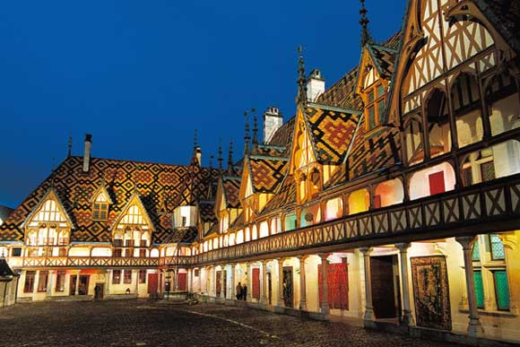
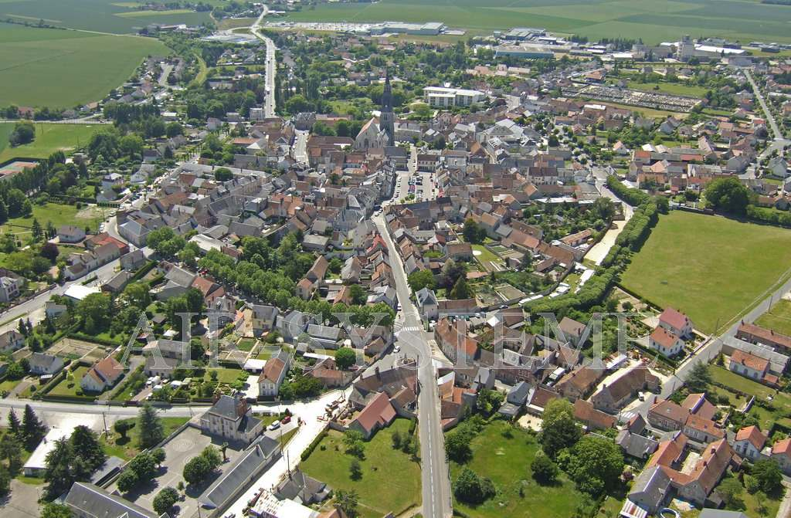
Discovering the town of Beaune…

Slide 3
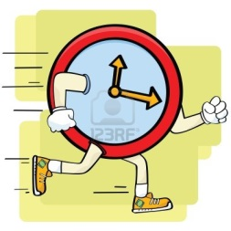
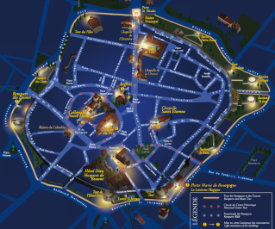
You have 1h30
To bring back the more clues you can
Related to the town of Beaune.

Slide 4
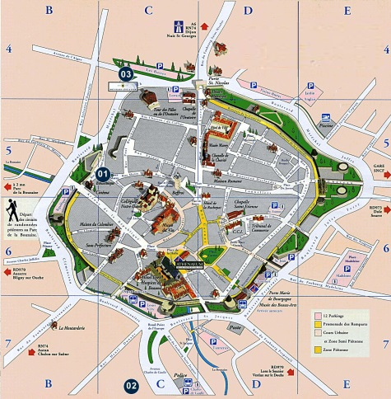
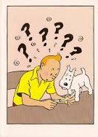
OR
OR
OR
OR
OR
Choose your path wisely

Slide 5
How does the app work ?

Slide 6
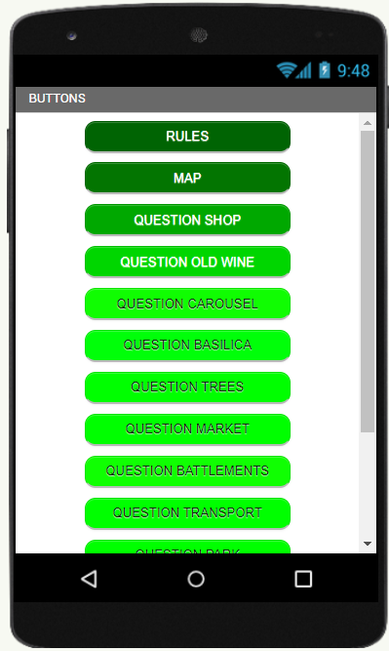
How does the app work ?

Slide 7
How does the app work ?
The fastest team wins 10 points
The second team wins 5 points
The third team wins 3 points
Each clue brings 8 points

Slide 8
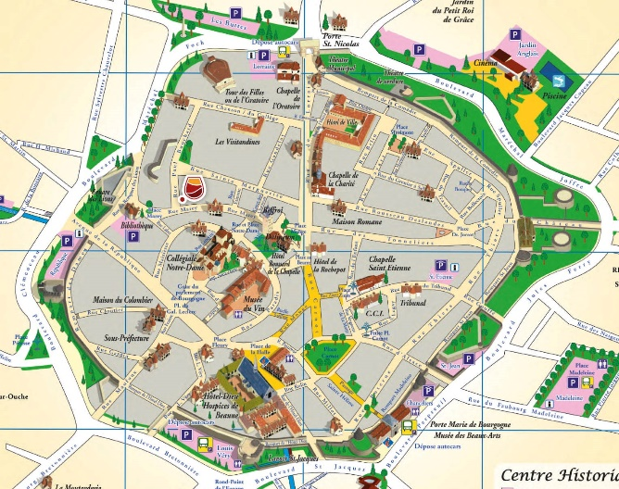
In order to win

Slide 9
TEAM 2
Cristina Sale (I)
Anni Arthur (S)
Julianna Hansen (D)
Serkan Topbas (D)
Eve Williamson (S)
Lucrezia Arezzo di Trifiletti (I)
Solenne Thorez (F)
TEAM 1
Amelia Ciadamidaro (I)
Lars Carlsen (D)
Anne Christensen (D)
Torsten Juhl (D)
Eva Cameron (S)
Rachel Earl (S)
Lily Fourcade (F)
TEAM3
Julia Lassen (D)
Nicki Wise (S)
Lois Ajilogba (S)
Allegra Lozzi (I)
Ludovica Longo (I)
Tobias Falkenberg (D)
Phellyx Baudoin (F)
TEAM 5
Pantaleo Boccia (I)
Laura Gibson (S)
Benjamin Pedersen (D)
Lena Fischer (D)
Kirsten Murison (S)
Edoardo Serra (I)
Ruben Crépieux (F)
TEAM 4
Ashleigh McGrath (S)
Linda Kubo (D)
Kate Fowler (S)
Sofia Leoni (I)
Marco Coccia (I)
Thomas Madsen (D)
Delphine Gourrin (F)
Farès Malek--Dureuil (F)

Slide 10
Arrival : Place Carnot

Slide 11
And the winner is…..

